Slide 1
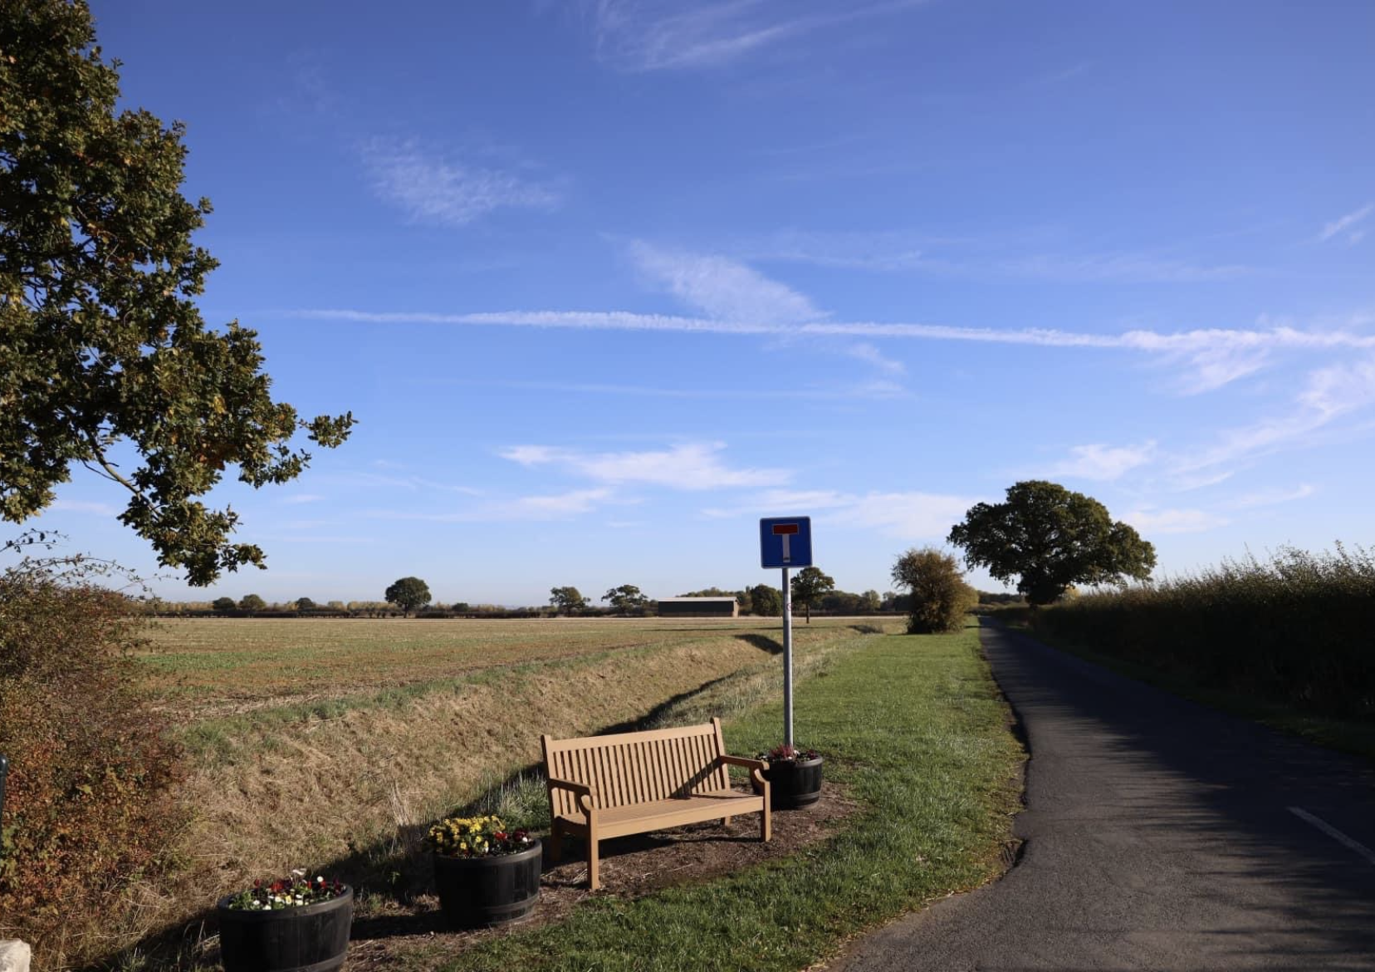
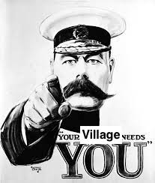
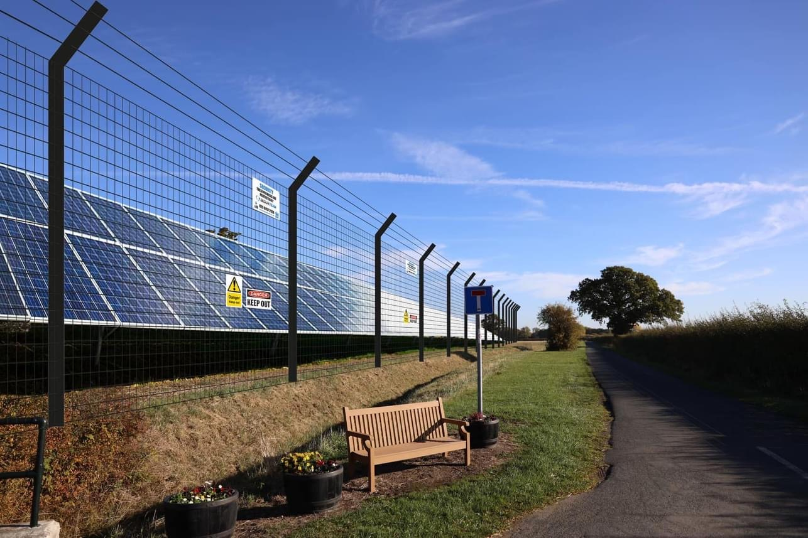
Bishopton Villages Action Group

Slide 2
Byers Gill - What is it?
A huge industrial level Solar development between Newton Aycliffe and Norton
Development by southern based developer - JBM
The company’s aim is to get these developments to planning stage. They will typically sell the project at that point for significant profit, with the buyer then actually constructing the development. From that point, JBM will likely have no further involvement – they have done their bit.
This development is not just solar panels. The gigantic size of the proposals mean a vast array of other infrastructure will be built around the areas in question
JBM plan to lease land from local landowners - These specific areas have already been identified
This is one of the largest Solar developments ever proposed in the UK. Internet search suggests only 1 development on planet similar in size - based in India.
This is a project on a National scale. It will not go to the borough councils for approval. This proposal will go immediately for approval to the government Planning Inspectorate – the dept who last week approved the new coal mine in Cumbria.
Notes:
No real notes on this slide. Just to talk around the bullet points.

Slide 3
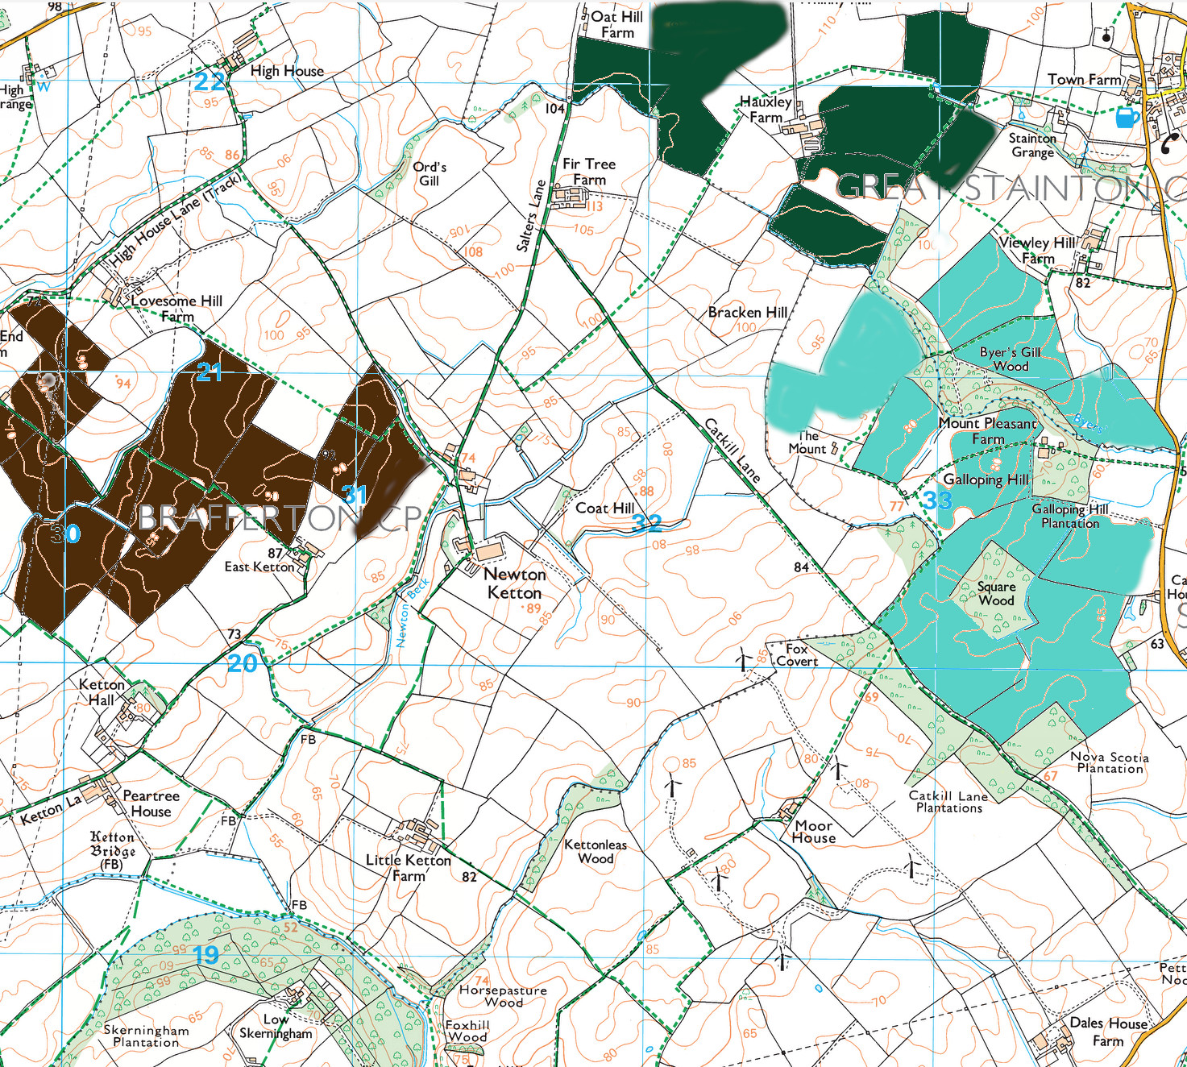
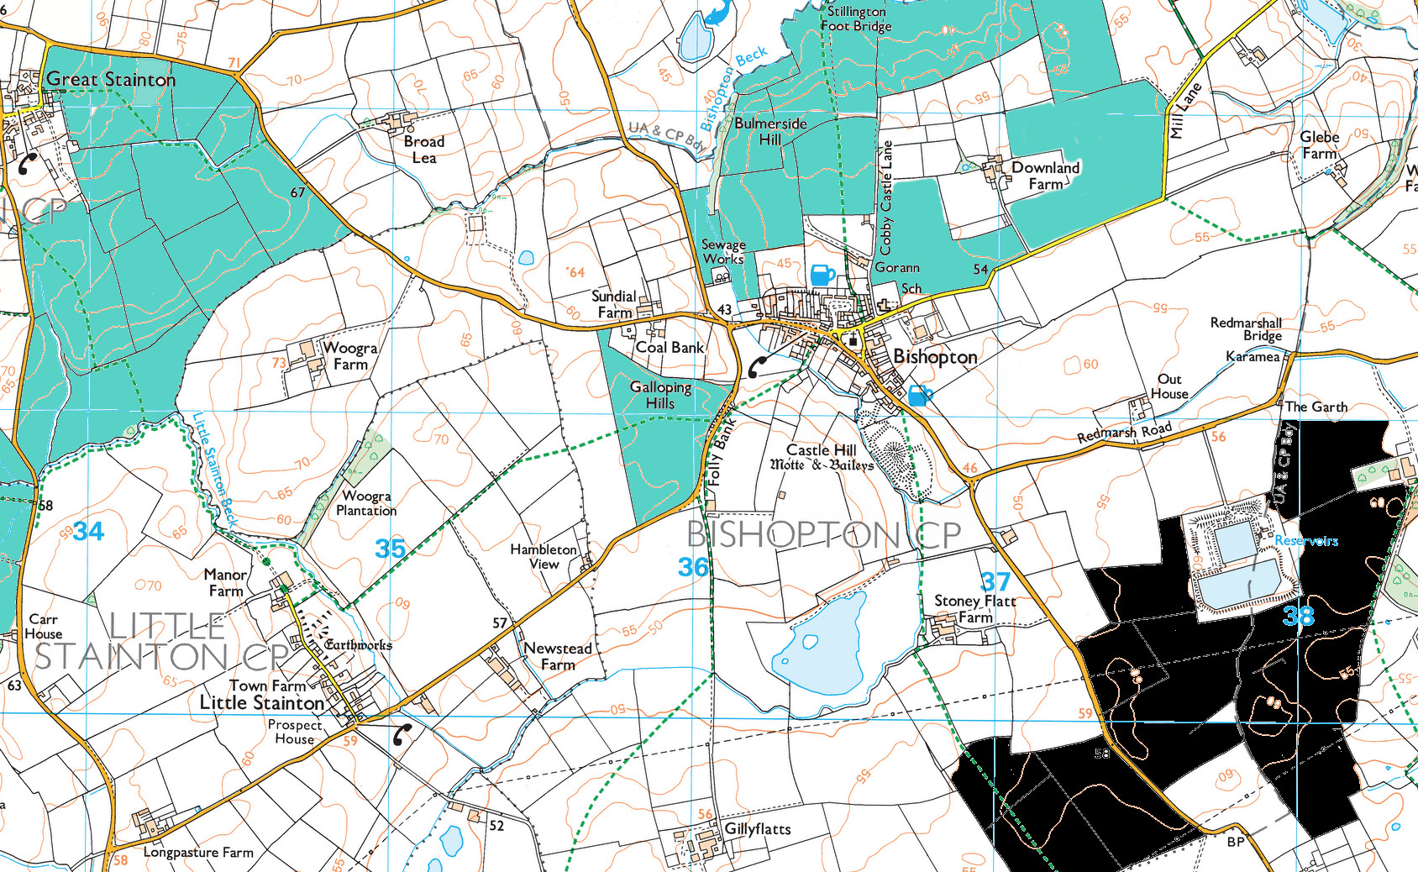
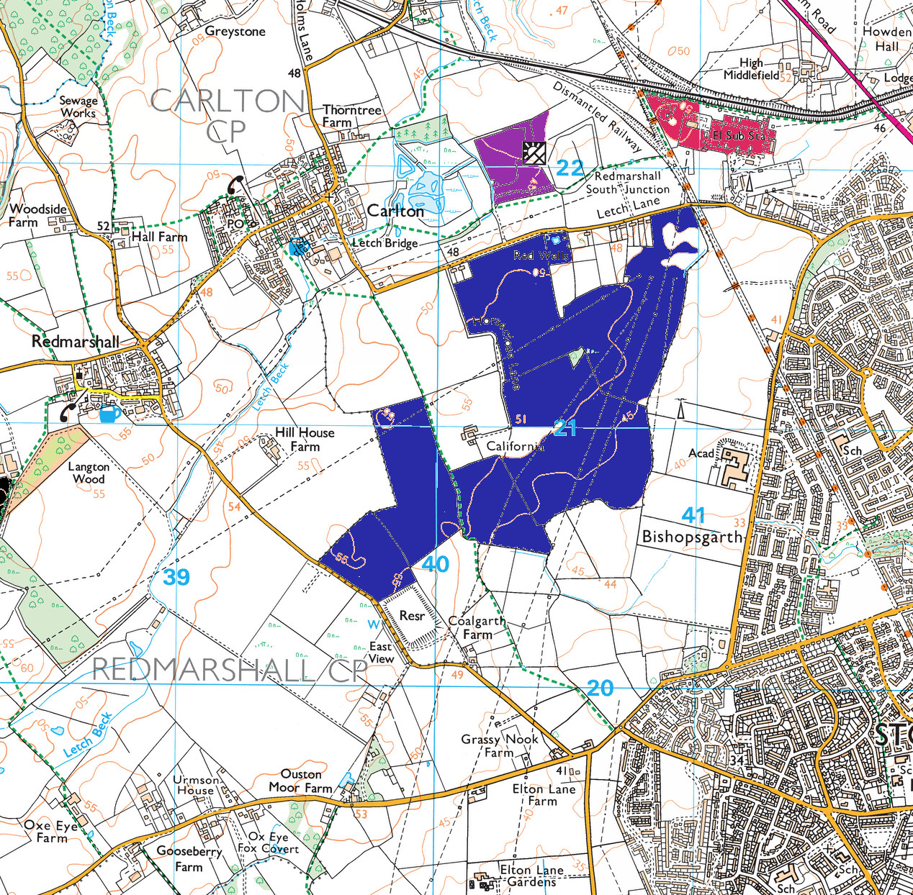
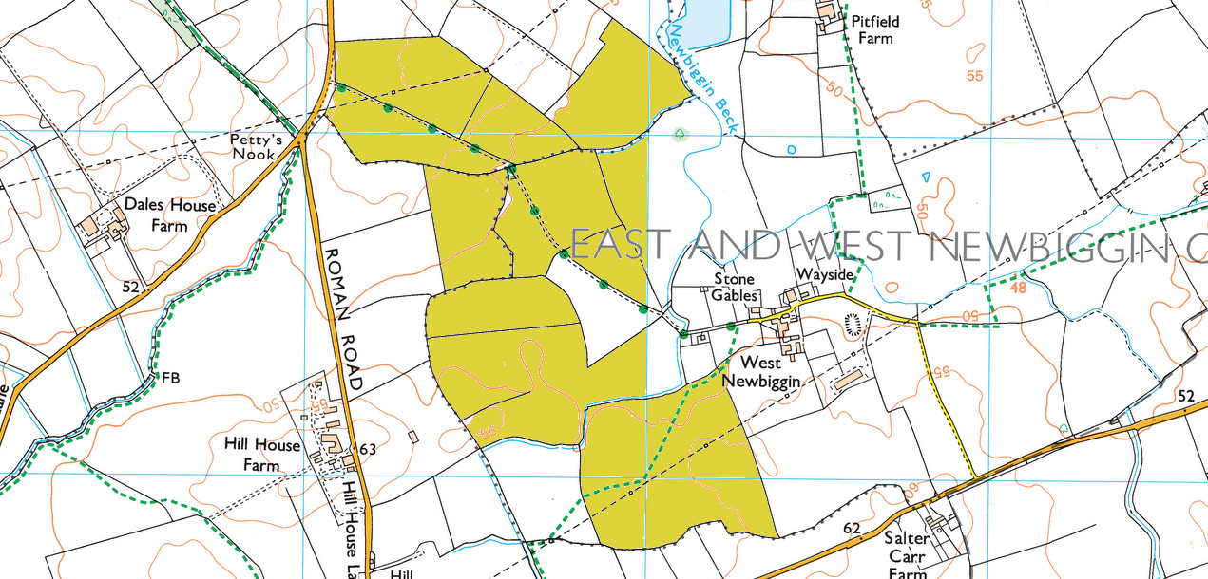
Why Here?
Location of Norton substation
Maximum profit for JBM
Landowners willing to lease land
Notes:
The Norton substation is the driver for this project. That grid connection is one of only a few in the country with current capacity to take the connections required – that alone demonstrates the vast size of this proposal.
Money – the above allows the developer the cheapest way to connect to the grid. Any alternative involving new grid connections involves more investment at the outset which would eat into the profit margin of the developer. They go with the cheapest option without consideration of local impacts.
Availability of land. There appears to be a number of landowners willing to lease their land as part of the project.
MARK - I think we said you were going to include an image that included the rest of the sites now I have created more space on this slide

Slide 4
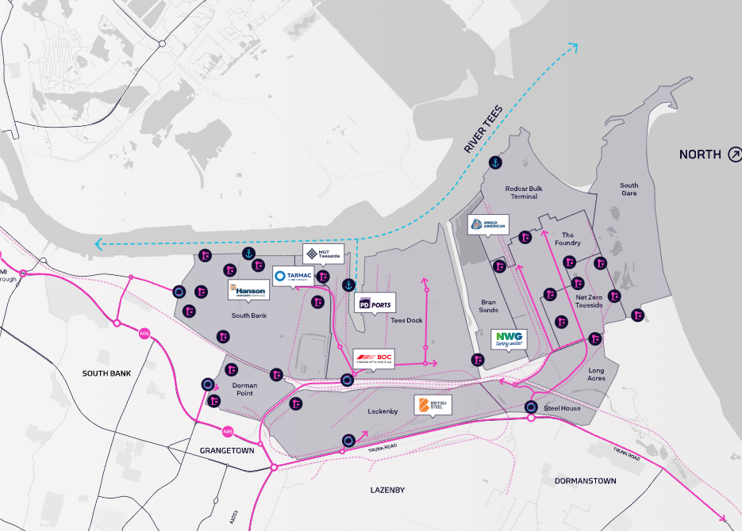
Alternatives
The Teesworks site is over 4500 acres, it could easily accommodate all of the
solar farms being proposed for our area……BUT this also demonstrates the scale of the project
Teesworks site recently tweeted the following:
“Our eyes are firmly set on the cleaner, greener, safer and healthier industries of tomorrow”

Slide 5
Factors Around Agricultural Land
Agricultural land is rated on a scale of 1-5, 1 being the best.
There is a sub 3a and 3b classification
Current legislation states 1,2 and 3a land is protected. 3b is not.
Most arable land used for food production growth is 3a or higher. I think most people will have witnessed the late summer harvests across the fields around the village which indicates they have been used for food crops.
However, the developer essentially self tests the land quality as part of their application. It is notable how may fields are reclassified from 3a to 3b as part of this process in other plans that can be viewed!!
3b can be used for Solar farms at present. A coincidence?
What happens afterwards? Who knows? Factories? Houses?
Notes:
Notes for last bullet - point to demonstrate is the unknown on what will happen to land afterwatds.
If downgraded, the landowner is essentially saying it is lower quality arable land. In the future, it may therefore be easier at the end of the 40 year lifespan of the panels to claim the land can not be reverted to arable land as it is poor quality by then (40 years with no fertilisation?!) and make it easier to obtain change of use for say housebuilding. This wont impact most people in this room, but will impact our children and the next generation.

Slide 6
The Overall Issues With Solar
Replacing an energy crisis with a food supply crisis
Much less efficient than offshore wind - 200 acres v 1 offshore wind turbine
Issues with toxic materials in the panels
Carbon footprint/waste materials
Questionable issues in the supply chain!
Lack of a sensible Government solar policy, indeed lack of ANY solar policy
Lack of common sense thinking….new build roofs, utilise brownfield sites
These are all frustrating points but all of the above are central Government issues to resolve. We cannot directly influence them and we all know how long Government take to arrive at common sense solutions, if at all.
Notes:
The risk of replacing an energy crisis with a food availability crisis. We are already seeing empty shelves at supermarkets. Each solar farm removes agricultural land from the UK food supply chain.
Generally, it takes about 200 acres to generate the same electricity by solar panels as ONE North Sea wind turbine. This represents a grossly inefficient use of precious land, whatever its quality.
Solar panels generate 300 times more toxic waste per unit of energy than nuclear power plants. They also contain lead, cadmium, and other toxic (even carcinogenic) chemicals that cannot be removed without breaking apart the entire panel. Worse, rainwater can wash many of these toxics out of the fragments of solar modules over time. (From The Committee for a Constructive Tomorrow (CFACT) a US-based nonprofit organization founded in 1985 that advocates for free-market solutions to environmental issues.)
The International Renewable Energy Agency (IRENA) in 2016 estimated there was about 250,000 metric tonnes of solar panel waste in the world at the end of that year. IRENA projected that this amount could reach 78 million metric tonnes by 2050.
There are potential issues with the carbon footprint of solar panels themselves meaning the electricity isn’t as clean as is claimed.
Potential issues with slave labour in China where the majority of panels are made.
Government seem unwilling to apply common sense strategy over Solar – why for example is it not law for new build homes to have solar panels on the roof?
I think everyone could agree that vast solar developments could be placed on brown field sites which would then not eat into agricultural land – the reason this doesn’t happen….it costs the developer more to get brownfield land ready, which again eats into the profit margin for them. They would also have to fork out on creating a grid connection. The most profitable way for the developer to go is to use farm land.

Slide 7
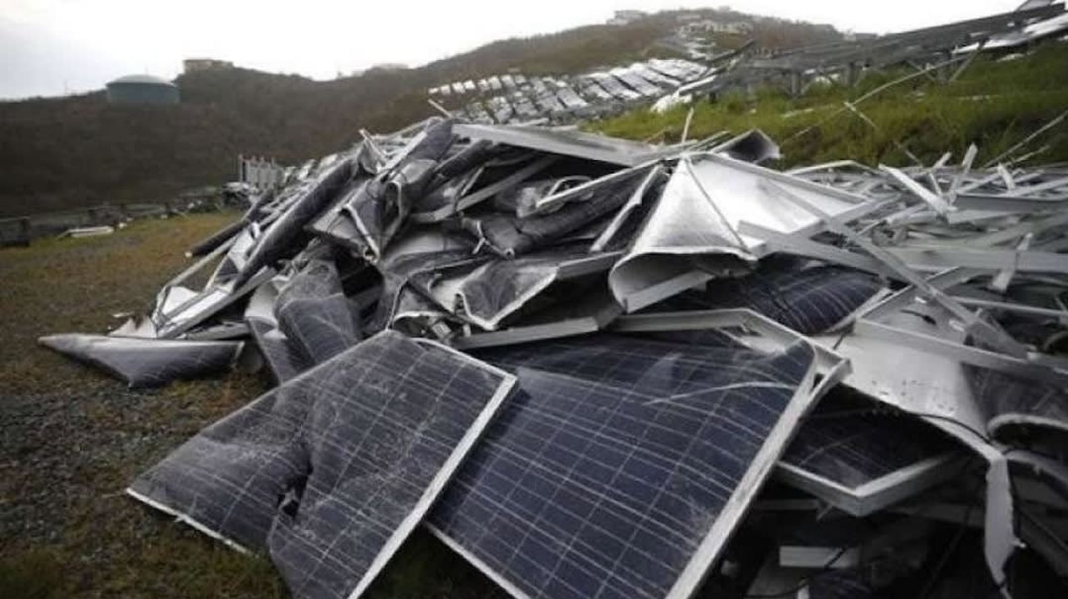
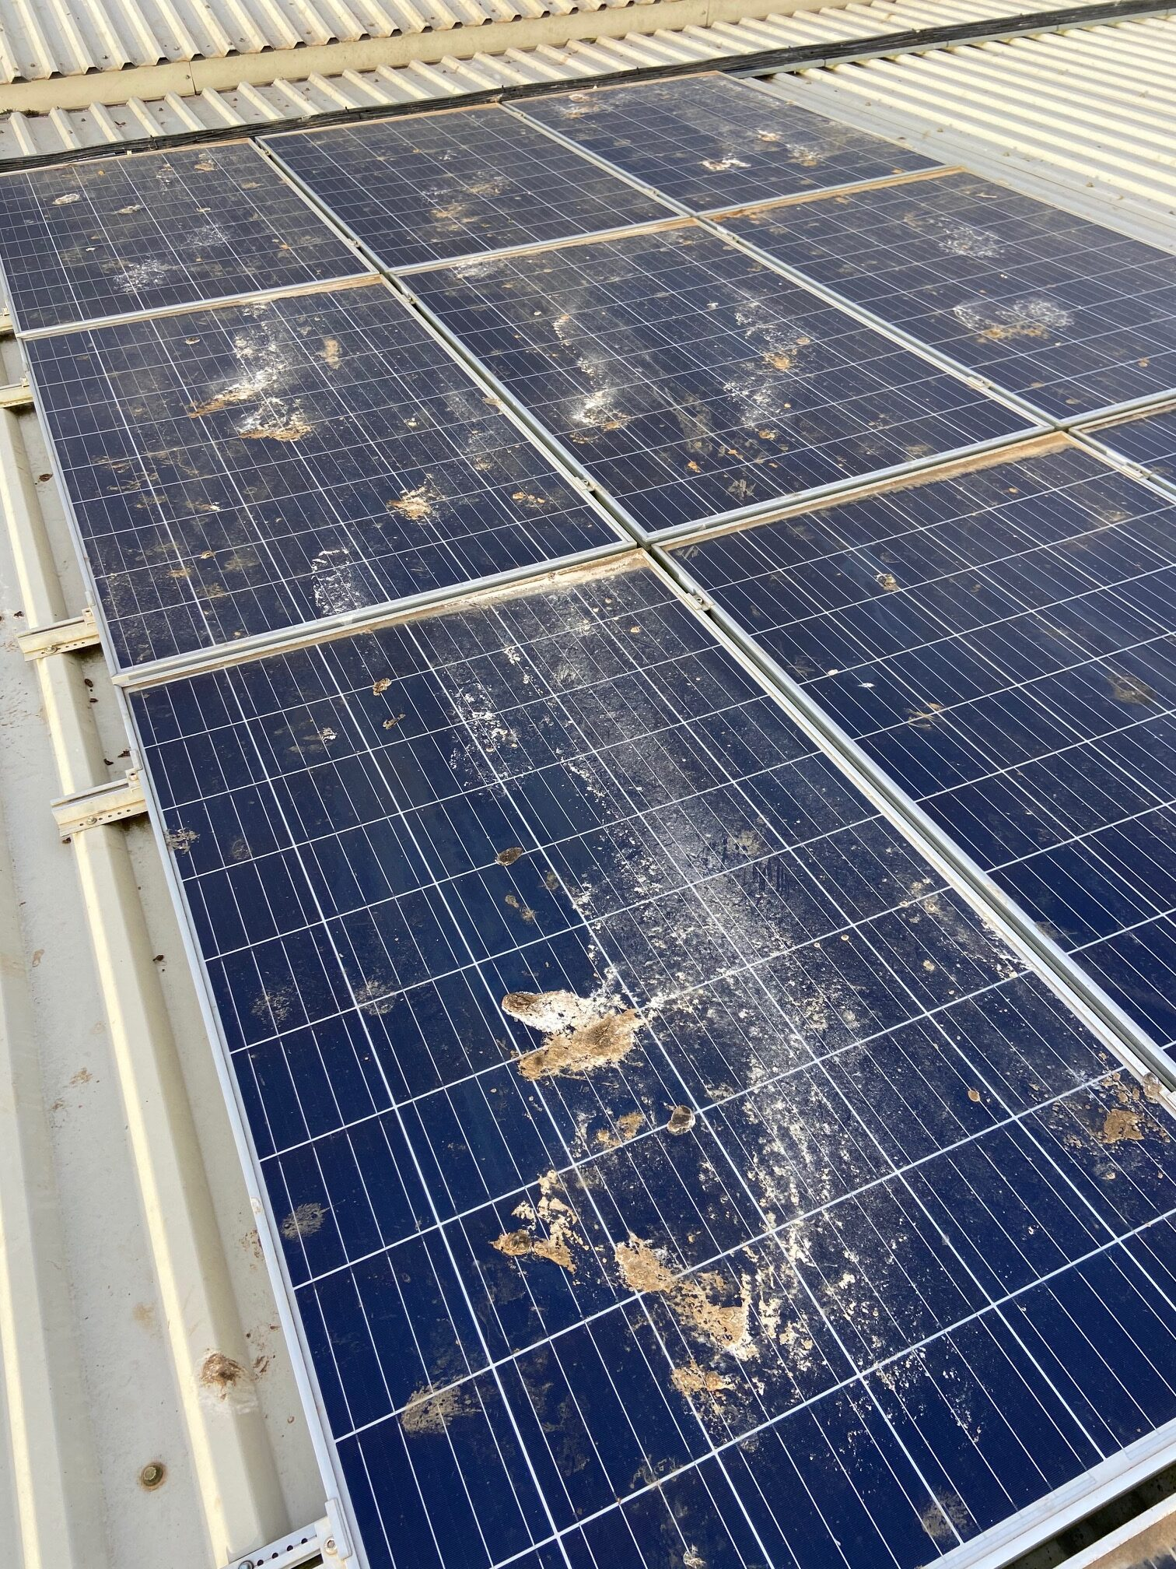
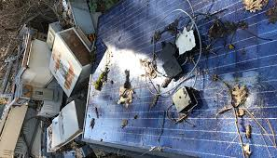
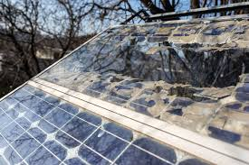
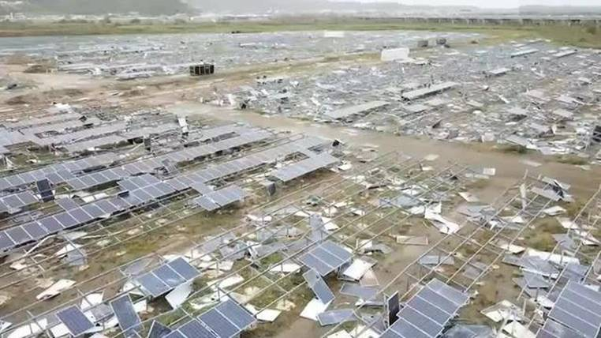
Sustainability?

Slide 8
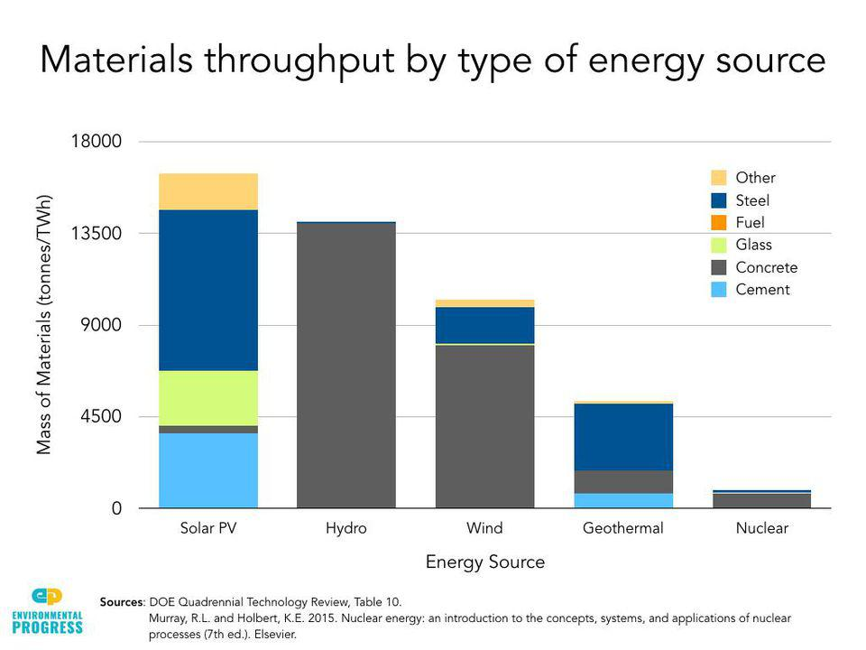

Slide 9
We are not against the principles of solar power or solar developments. They clearly have their place in a modern world moving away from fossil fuels. Renewables are the future of electricity generation.
We are not opposing the general plan for the UK to invest in Wind and Solar.
Why Oppose These Plans?
So what is the issue here for Bishopton and its surrounding villages and residents…
THE SPECIFIC INCONSIDERATE DEVELOPMENT ASPECTS OF THE BYERS GILL PROPOSAL
The Byers Gill development has a number of stakeholders:
The Developer (will make a vast amount of profit from this)
The landowners (Cash inflows throughout the life of the project)
The Grid - electricity generation. It is important to understand electricity generated will go into the Grid system. It will not be utilised specifically by local residents nor will there be any direct savings to local residents electricity bills
The electricity companies – more electricity to sell, more profits to make
    The local residents and community are the bottom of the list in terms of consideration of impacts.
    This development is being undertaken by a Southern based developer and the decision will be made in Whitehall by a civil servant who has never visited the area and signed off by a Secretary of State who isn’t from the area.
We must therefore stand up for ourselves, be heard, and be counted.

Slide 10
The Local Impact
This isn’t just about solar panels. People may think if they cant see a solar panel from their home, this wont impact them - Think again!
The infrastructure here is vast including: cables, huge storage batteries, CCTV units on poles, fencing, service roads, antennae linking the various sites
Fields of solar panels or an industrial complex? The location of this infrastructure covers virtually every field surrounding the village, on every approach, with a significant element of it behind the high street to the South
To date, most solar developments have been on individual fields of a certain size, largely hidden from roads, set back, and fundamentally away from residential properties and villages
Byers Gill changes that. This is one of the first developments that encroaches onto residential areas so closely.
The visual impact is only one of several – and to a point the visual impact on us may actually be the least important. This development could change our life’s forever.
We all live in Bishopton as we were either born into a rural life or moved to a rural area for the benefits that can bring. This will change so many aspects of what makes our home our home.
Scope creep. A HUGE RISK
Notes:
First and foremost this isn’t just about solar panels. People may think if they cant see a solar panel from their home, this wont impact them - Think again!
The infrastructure here is vast including: cables, huge storage batteries, CCTV units on poles, fencing, service roads, antennae linking the various sites
Fields of solar panels or an industrial complex? The location of this infrastructure covers virtually every field surrounding the village, on every approach, with a significant element of it behind the high street to the South
To date, most solar developments have been on individual fields of a certain size, largely hidden from roads, set back, and fundamentally away from residential properties and villages
Byers Gill changes that. This is one of the first developments that encroaches onto residential areas so closely.
The visual impact is only one of several – and to a point the visual impact on us may actually be the least important. This development could change our life’s forever.
We all live in Bishopton as we were either born into a rural life or moved to a rural area for the benefits that can bring. This will change so many aspects of what makes our home our home.
Scope creep. All applications are dealt within their own right. As people saw recently with Gately Moor, the approval is based on that one application only. They do not consider other applications either already approved or in the pipeline. This means no one considers the cumulative effect of approval after approval of these schemes.

Slide 11
Examples of Impacts
Human health
As of this week, the developer is claiming they do not need to consider the impact of this project on human health!!
Asbestos scandals of the past, Cancers from mobile phone masts, recent cladding issues (Grenfell)
Lack of studies on human heath of huge electro magnetic fields (pacemakers?)
Other countries purposely keep these things away from humans
Dogs and horses
    A rural village becomes an industrial site
Disruption to lives
Noise
Notes:
(Newbury horse deaths: Investigators remove cable from racecourse | Daily Mail Online)
Health – this complex will create a huge electro magnetic field around the village. There are studies particularly in the US about the health impacts of that on humans. This is new technology, by definition no one has therefore lived so close to this level of electro magnetic activity for any sustained period. We are being put in the middle of it for 40 years minimum. We are being treated as guinea pigs to an extent as no one truly understands the impact on the human body of such sustained exposure. There are no real life studies of this level of electro magnetic activity on things like pacemakers
If you trust the government to worry about that and protect us….perhaps have in mind the asbestos scandals of the past and more recently the apparently safe cladding installed in buildings such as Grenfell. We should not be expected to be the subjects of a 40 year experiment to determine if these things are safe to be around humans. Other countries keep such large scale developments away from people
Dogs and horses. The equipment emits noise at a frequency that is much more impactful on horses and dogs. Horse riders and dog walkers will appreciate when an animal becomes spooked, the results can be disastrous. It is no surprise therefore that there are numerous examples of objections to other schemes on equestrian grounds
There are examples of cables buried beneath the earth causing fatal electric shocks to horses – in 2011 at Newbury racecourse for example where horse shoes reacted with the electro magnetic fields emitted. The cables were subsequently dug up and removed for the safety of the horses
(Newbury horse deaths: Investigators remove cable from racecourse | Daily Mail Online)
The rural atmosphere - The sites will be at virtually every single access point to the village. Once complete, Bishopton in particular will cease to exist as we know it. Rather than be a rural village in the countryside, Bishopton becomes simply a group of houses surrounded by fields of metal boxes
Disruption to lives. As stated previously, this site is enormous. We will be living in the middle of an industrial scale development site for years. Vast amounts of HGV traffic through and round the village for an unspecified period

Slide 12
Examples of Impacts
Permanent industrial activity
Service roads built, HGVs behind peoples homes
Encirclement of village – EVERY HOME WILL BE IMPACTED
Cabling run around the village AND directly through it
Felling of trees
Impact on mobile phone reception in the village
The ‘castle’ field will not be spared
Notes:
The ongoing industrial activity through use of service roads. These cut across fields, behind peoples houses and generally cut up the local area significantly.
People walk around the village for fresh air, the views, the peace and quiet and general well being. The extent of these proposals will impact that. The level of battery/storage units alone will impact that. These units are larger than shipping containers.
The panels themselves are not low to the floor. The proposals are for panels 4 metres high, with security fencing much higher. Walking through them will cease to be a walk in open fields.
The village itself. Much of the plans involve running cables through the village. These cables are industrial scale cabling, not your regular TV or phone wiring.
Some people may have recently noticed the tree surveys taking place on behalf of the developer. If the trees impact the cabling in any way, such as through root mass interference, the trees wont just be lopped, they may be torn down completely. Once things like this are gone, they will never return.

Slide 13
Examples of Impacts
Safety – smashed panels, broken glass, leaking chemicals – high winds!!!
The school – A significant risk to the long term future of the village school
The long term future of the village full stop
THIS PROJECT IS A THREAT TO US ALL AND THE WAY WE ENJOY OUR HOMES AND VILLAGE.
Notes:
Safety - In the recent high winds, people may have seen the impact on a similar solar field near the A19. Smashed panels, leaking chemicals, heavy loose objects scattered across the field. This remains unrectified a year on.
The school - A significant part of this development is right next to the school. The school is important as a village school. A rarity in the modern UK. There is a real risk that parents would remove their children from the school if there are safety concerns. Once numbers reduce, the existence of the school itself becomes questionable. This is a very real risk.
The long term future of the village - This may deter inward moving families, Once that happens, the village may decline, once numbers reduce, local businesses will also be impacted.

Slide 14
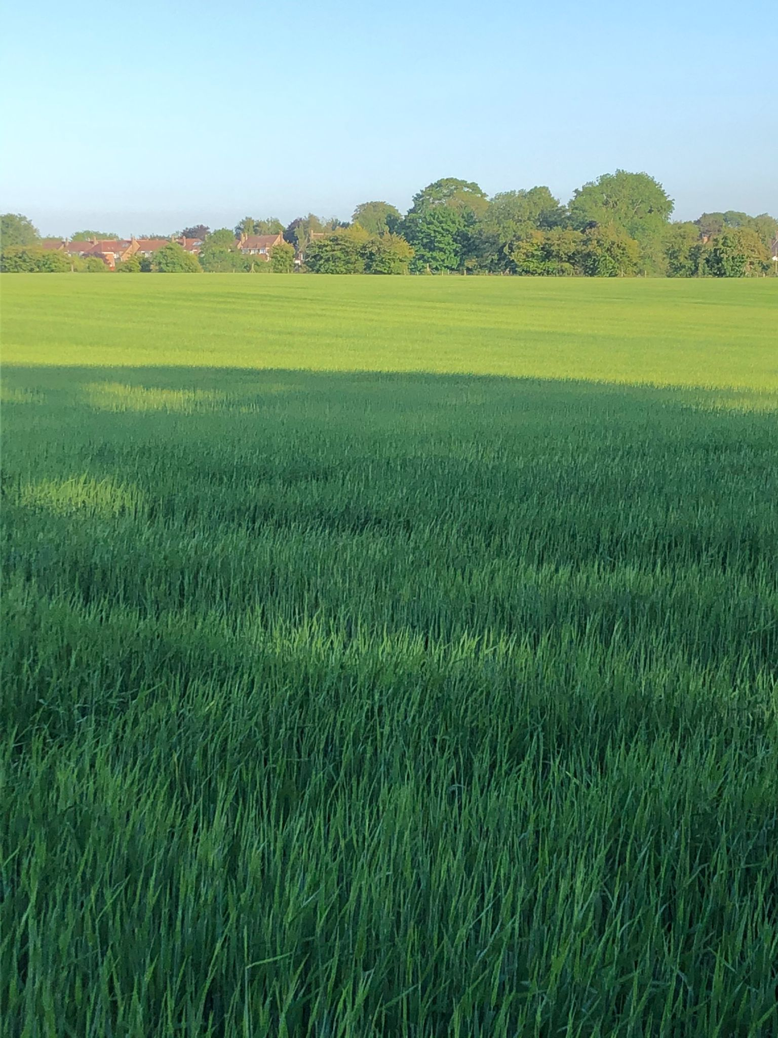
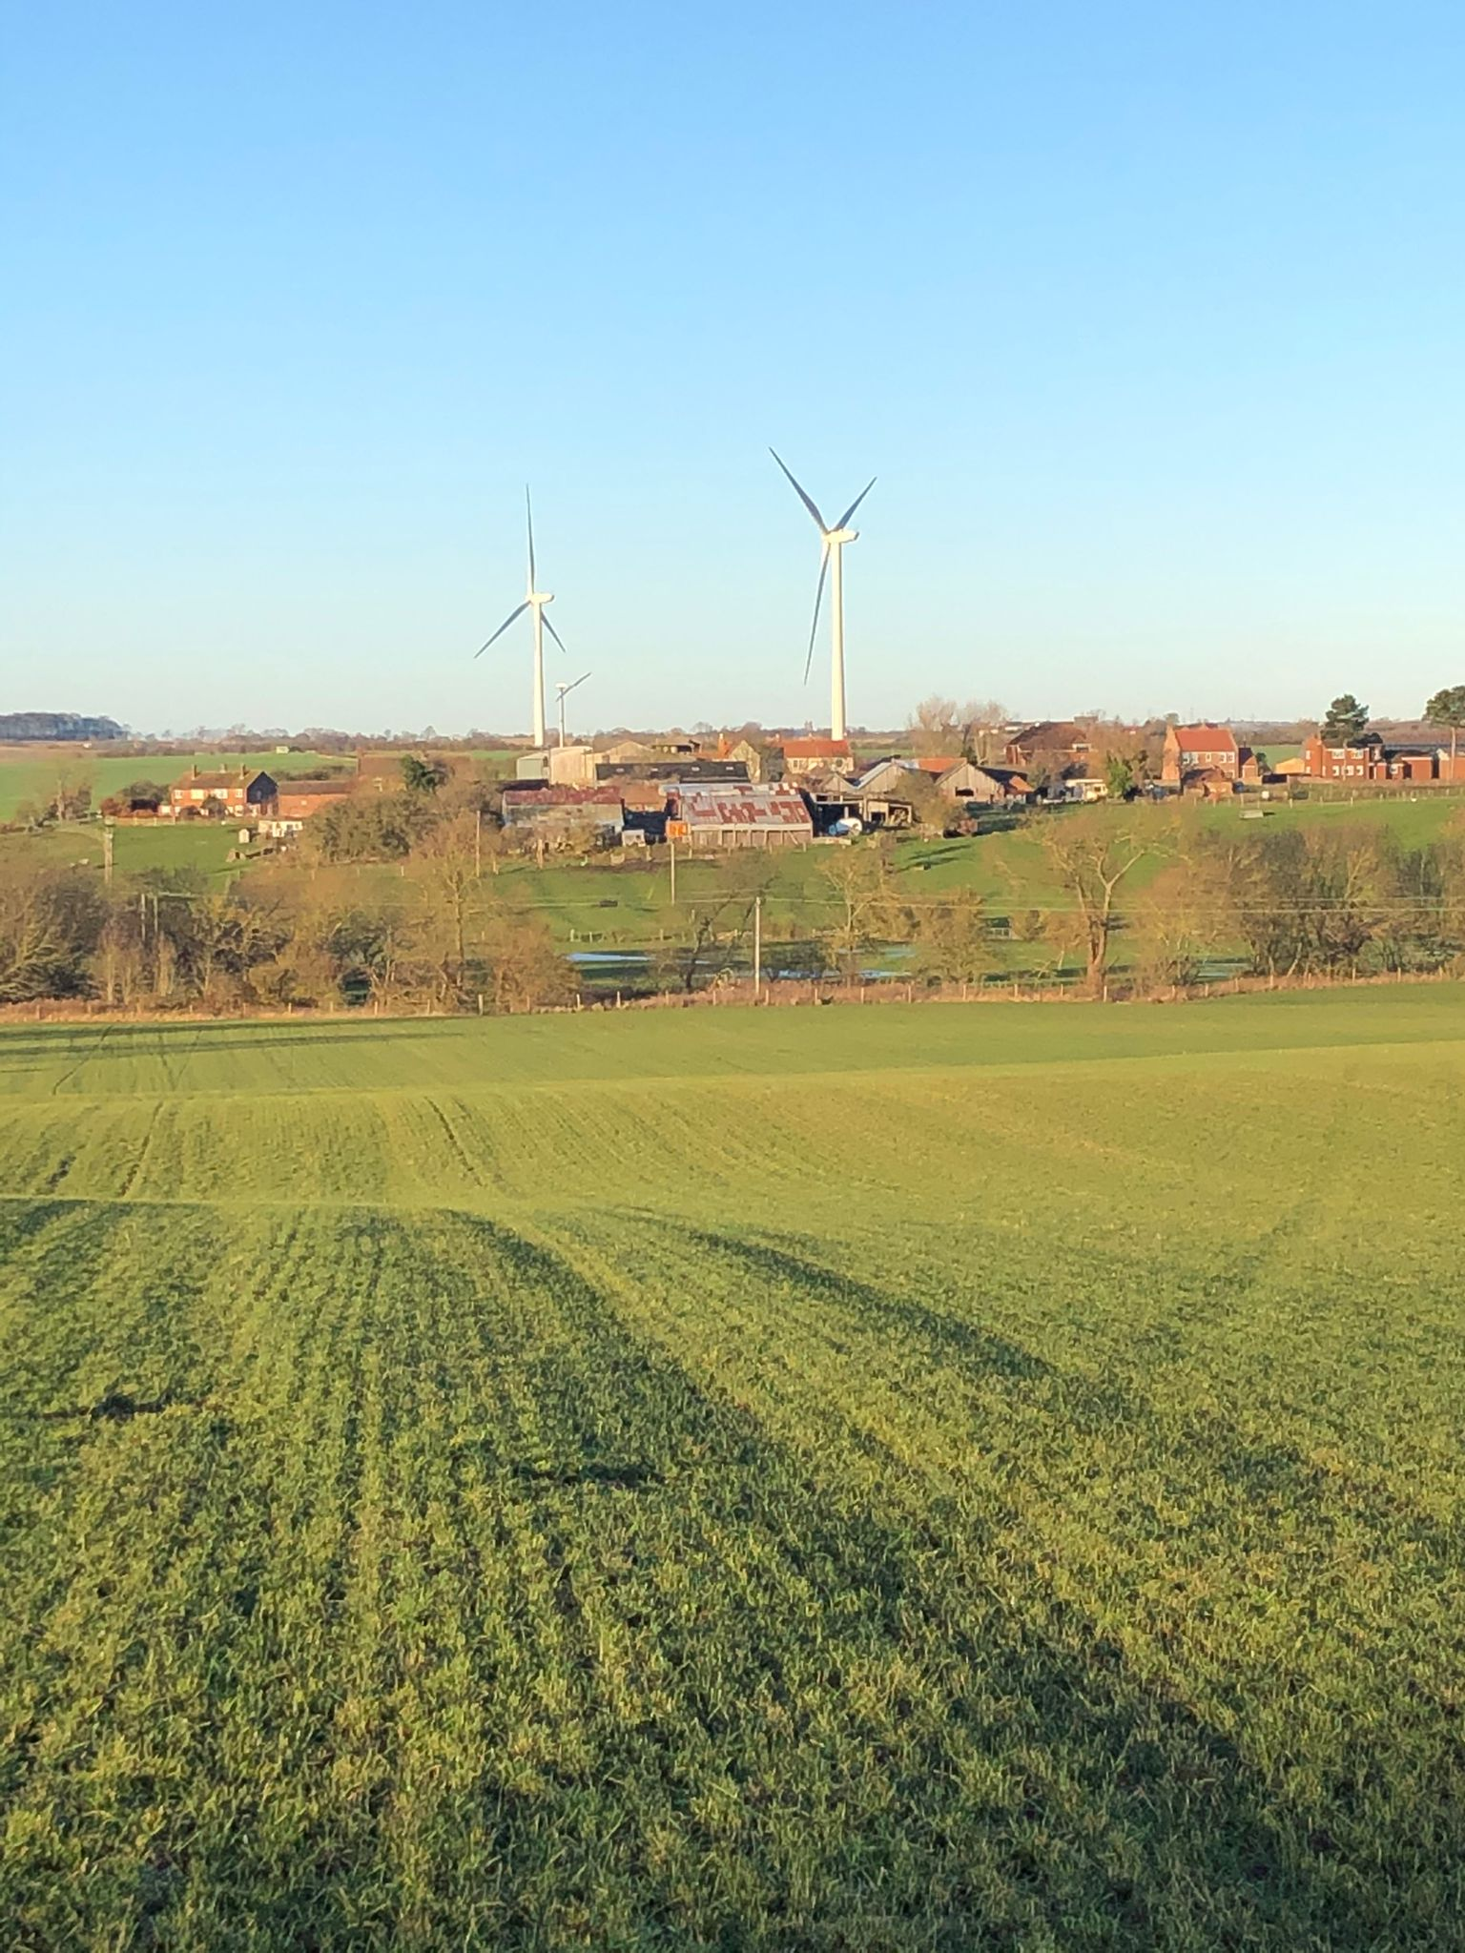
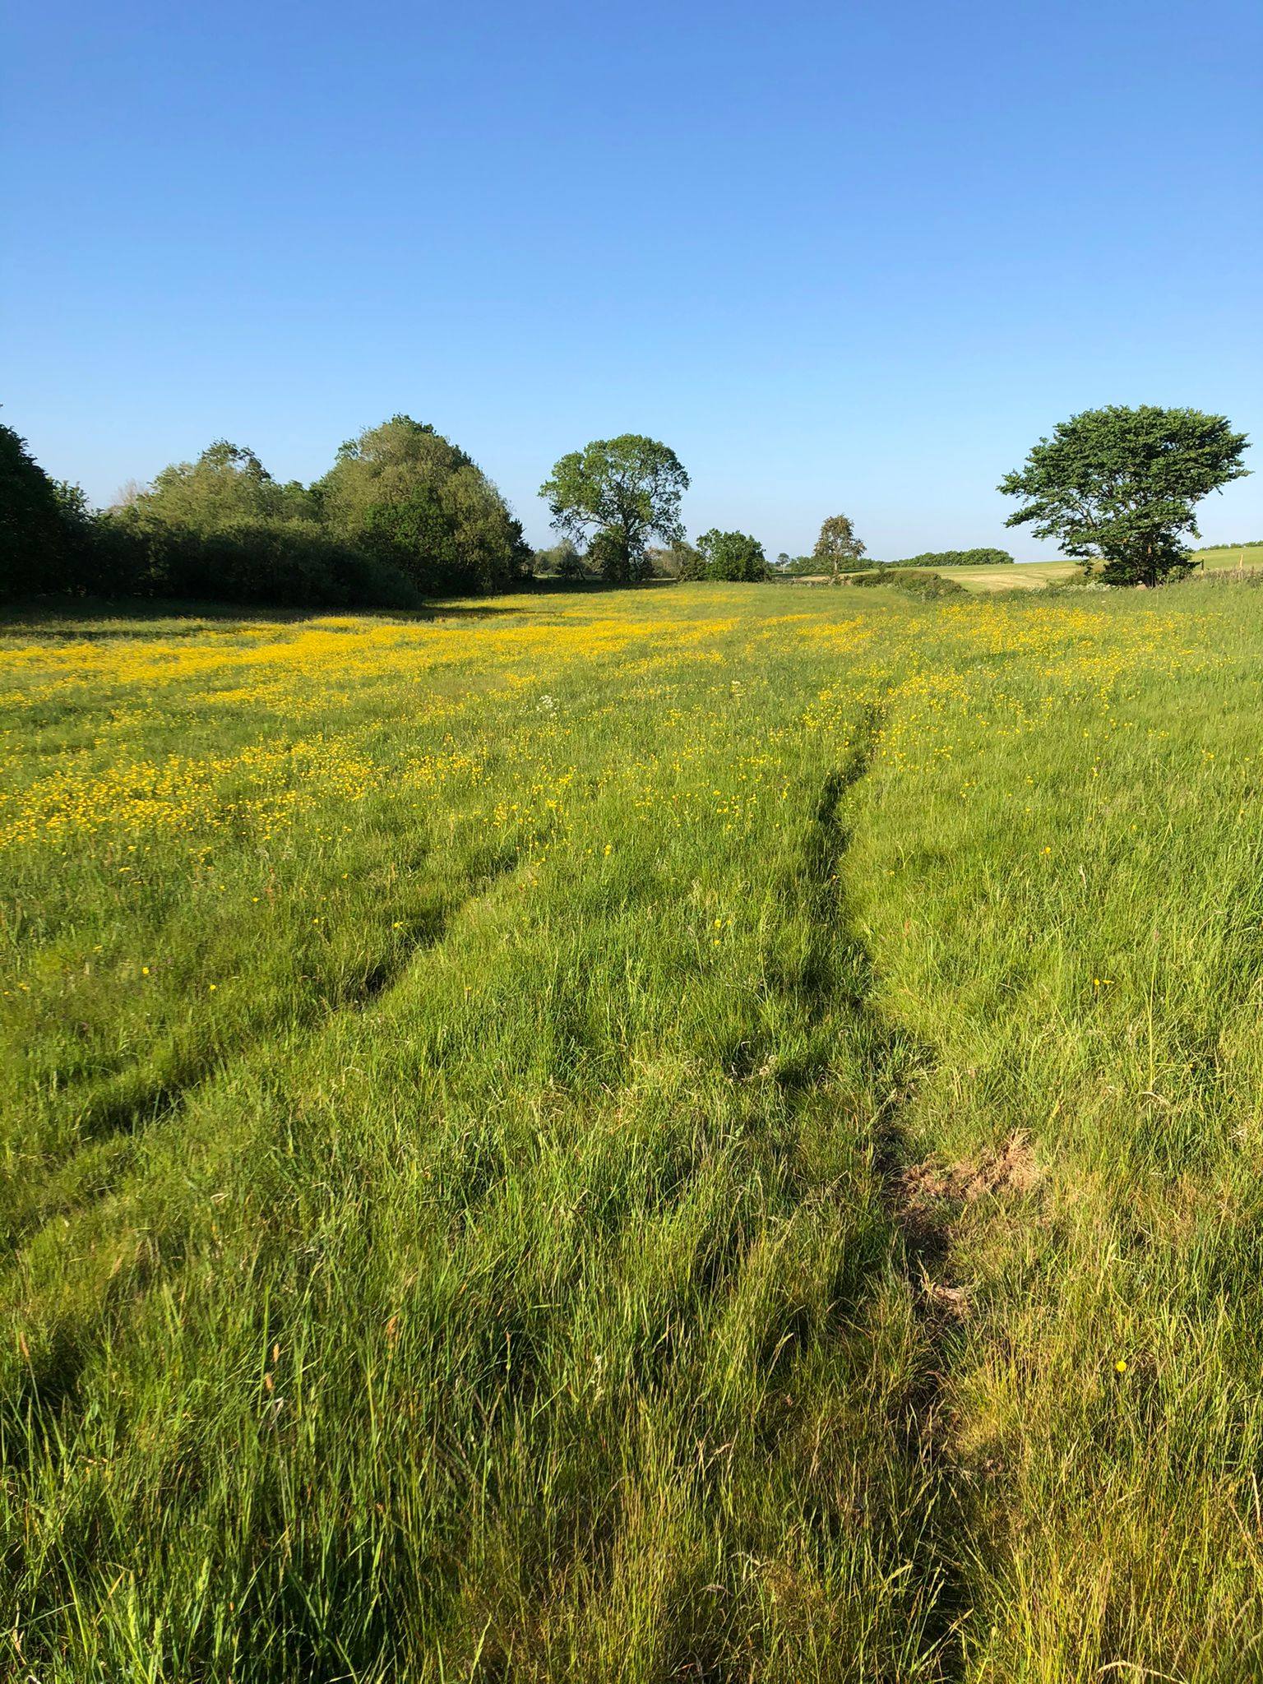
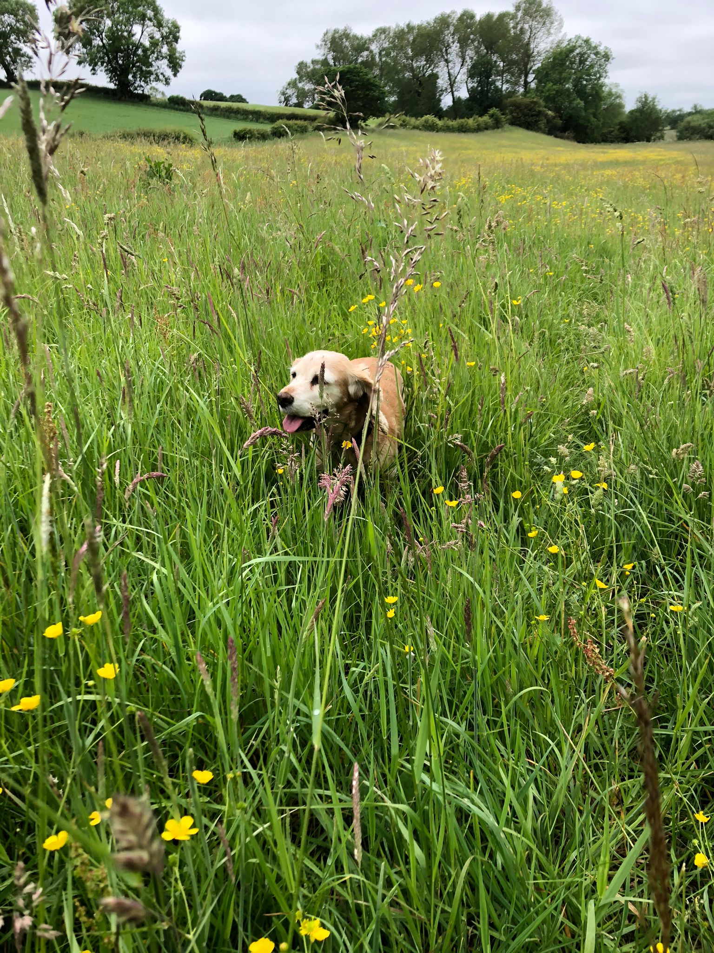
What we Love About Where we Live

Slide 15
What are the potential positives for us…
1.
2.
3.
4.
5.
ANSWERS ON A POSTCARD!!!

Slide 16
What can be done…
JBM are a polished outfit. This is what they do. Sign up landowners, obtain planning, make profit and move on to the next one!
There is already a 400 page pre scoping document (all of the points in the flyer come from that document).
However, all is not lost. If we stick together, our voice can be loud and be heard. You need to fight for your village.
There are a number of aspects of the plans that require methodical challenge. This is more than just raising objections in the usual manner to planning applications.
The project is currently in the consultation stage. However, you should understand this is only happening because it is mandatory. Policy dictates that if a project meets the size of a National Infrastructure Project, the developer must perform a local consultation. JBM are doing this ‘consultation’ because they have to legally, not because they want to. There are also no requirements whatsoever for them to listen to any of the points raised in the consultation process.
Once the consultation process ends in early 2023, the plans will be submitted to the Planning Inspectorate for review and approval.

Slide 17
Help Needed!!
In order to get the Planning Inspectorate to take our concerns seriously, we need help on a number of things:
  Lobbying – local politicians and local borough councillors. Making our concerns widely known could have an impact. The more voices the better,
  Fundraising. Inevitably money will be needed for professional assistance in our formal objections.
  PR – local media, radio, newspapers. Anyone who can help make the wider community aware of the INCONSIDERATE PLANNING.
  We need volunteer researchers in various areas to help formulate the formal opposition response….in areas such as….
        Health, Environmental, Animal, Bird, Noise, Visual, Safety, Highways/access/road safety
If you need any further information on the scale of how this will impact you…simply spend some time reading JBM’s own 400 page proposal document. 400 pages worth of impacts!!
All documents and website links are now available to review on the Action group website: bishoptonvillagesactiongroup.org

